Slide 1
NAEP – New England
Janet Garabedian, business development manager – October 24, 2022

Slide 2
who is the MHEC?
i-buy marketplace and demo
contract updates
C04 – mattresses
D04 – gasses
F11 - Print and Promotional
F15 – office supplies and equipment
F22 – Value Added Reseller
G29 Facility Maintenance and Energy Assessment Software
G02 Exterior Maintenance, Equipment, Repair, Supplies and Services
G10: Domestic & International mail
G19: Home Depot – rebate program
enhanced website
1st Monday monthly member digest
expo – recap
agenda

Slide 3
about MHEC
MHEC is a not-for-profit Group Purchasing Organization (GPO).
We’ve been creating diverse contracts for our New England members for over 45 years.
Our contracts remove the complex process of going to bid, making purchasing simple.
Notes:
MHEC has been around for a long time, but for those of you who don’t know us, not-for-profit, just like most of you.
We are a New England group purchasing organization and our main role is to create and manage a large portfolio of contracts that remove the complex process of going to bid. This takes a huge burden off of our members and makes purchasing simple.

Slide 4
the value of using a GPO
The more members, the more spend.
The more spend, the more leverage to drive down costs.
Notes:
If you have never belonged to a GPO, it enables economies of scale. The more members, the more spend.
The more spend from suppliers on our contracts, the more leverage our strategic sourcing managers have to drive own costs.

Slide 5
who uses MHEC contracts
New England not-for-profits with an educational component
k-12
higher ed
libraries
cities & towns
public
private
parochial
charter
vocational
public
private
public
private
administration
facilities
fire and safety
public works
water
as well as other educational non-profits, healthcare non-profits, housing authorities, museums and societies
Notes:
Part of the value of our contracts is that we have a diverse community of members that are comprised mainly of libraries, cities and towns, K-12 schools, and higher education. As libraries, you touch almost every sector.
As you cans see we have contracts that meet the needs of a broad ranges of members within these sectors.

Slide 6
why members should use MHEC contracts
simple
savvy
diverse
ease of use contracts
no quoting requirements
not-for-profit
trustworthiness
supplier relationship
support
i-buy marketplace
compliant with state bidding laws
competitive and transparent
member advocates
trusted advisor
dedicated support
50+ other contracts
2500+ members = purchasing power
New England region only
continue to add small, minority, women-owned, veteran owned and other diverse supply partners
Notes:
Why should libraries use mhec contracts?
We’ve created a simple process for you to use our competitively bid contracts that eliminates the need to meet quoting requirements because we’ve already done that for you.
As a not for profit, we experience no gains from raised prices, supplier deals, or product selections. This is a trust factor that makes the choice to use us simple. The relationship we have with our suppliers helps and the support we provide to our members makes it an easy choice over competitors.
IT’s also that the MHEC team of strategic sourcing managers know what they are doing. They have all been trained in the rigors of the MA general law chapter 30b requiring a transparent and competitive process for going out to bid on a contract. This rigor transcends state lines, so even though our sourcing managers are certified in Massachusetts state law, it complies with the tenets of the five other New England states. As a trusted advisor with dedicated support. we’re positioned to be your advocate.
Lastly, MHEC contracts are diverse. We 5 contracts that have been built to meet the needs of our library members. Plus we offer over 50 other contracts that libraries can use to take care of their facilities, furnish their interiors, maintain their exteriors, and more. We have over 2500 members that provide purchasing power I spoke of and we are a regional GPO that offers local suppliers as well as national suppliers and brands.

Slide 7
how to purchase products
Notes:
There are basically 3 paths you can take to purchase from an mhec contract:

Slide 8
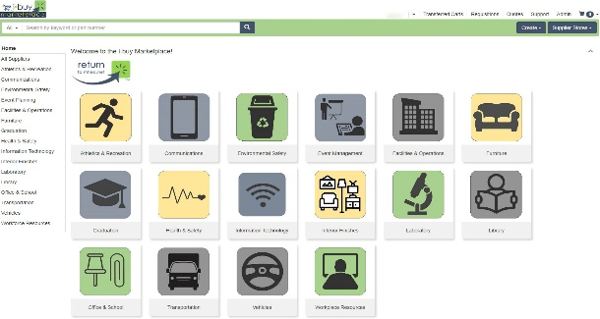
3 paths to purchase
RFQ
PO
direct contact with the supplier
direct through i-buy marketplace
i-buy and supplier
PO
shopping cart transaction
uses i-buy to search, RFQ, send PO through i-buy to supplier designated contact
choices depend upon:
type of product or service
whether there is an online store on i-buy
member preference
Notes:
You can go directly to a supplier supplier with a PO
You can go direct throughthe i-buy marketplace using a shopping cart transaction
Or, by using i-buy to search, request a quote, and send a PO through i-buy to supplier designated contact
Choice of path really depends on:
type of product or service
whether there is an online store on i-buy
Or, really….just member preference

Slide 9
6 key benefits
streamlined request for quotes
pay by POs, credit cards, or P-cards
single-cart checkout-even with multiple suppliers on different POs
administrative controls
search for diverse suppliers
product comparisons
i-buy market
Notes:
Today, I am going to demonstrate a new online purchasing tool we launched earlier this year called the i-buy marketplace. It’s very similar to other online marketplaces that you may have already used and offers a simple way for libraries to purchase items from MHEC contracts. With over 50 contracts including 5 specifically for libraries you can use i-buy to purchase items ranging from books to building supplies, subscriptions to snowmelt, computers to carpet, and furniture to facility supplies.
It gives you an easy way to search for products and gather quotes from multiple suppliers of those products all at once.
You can pay for your purchase your way, whether by PO, credit cards, or P Cards.
The single cart checkout function enables you to buy different products offered by different suppliers and even using different payment methods—all from the same cart.
Administrative controls help ensure only in your organization that are authorized to buy can do so.
There is a specific search function that allows you to find diverse suppliers to help you meet your diversity goals.
And finally, i-buy enables you to make product comparisons so you can decide which item fits your needs best.

Slide 11
i-buy marketplace launched April 2022
simple, searchable, compares items/pricing
easy check-out
free to all mhec members

Slide 12
i-buy training opportunities
Wednesdays at 1:00 we have a scheduled webinar on i-buy
Janet Garabedian can come to your organization or conduct a webinar for your team
sign-up and you receive a Sherpa blanket
Notes:
There are several ways in which you can get a more comprehensive training on i-buy.
MHEC has a standing webinar each Wednesday at 1:00. We post the schedule each month in our monthly magazine, 1st Monday. We also, email invitations to member sectors each week.
A second way is to contact our team to have Janet Garabedian either come to your organization or conduct a webinar for your team
And lastly, we have team members that go to association tradeshows and provide overviews of i-buy from our booth.

Slide 13
we are looking for a couple of institutions to be early adopters!
we will come and train your end users and administrative people
we are looking for an excellent result with a great reference from your campus to share with other members.
any volunteers?
early adopters!

Slide 14
Heather Ludden Marketplace manager i-buy@mhec.net
need i-buy help

Slide 15
contract updates

Slide 16
7 suppliers offer a variety of mattresses.
2 suppliers exclusively hospitality products
nationally competitive pricing with volume discounts available
dorm mattress warranties range up to industry leading 7 years
specialized medical mattresses offered.
some exclusive contracted suppliers
8 of the 9 awarded suppliers are Small Business or Diverse Business
dorm kits available, including to students.
C04: mattresses

Slide 17
D04 has a wide portfolio of gasses and services available to all six New England States.
all-inclusive pricing models and traditional pricing models are available.
now includes bulk gasses.
additional volume discounts may be available with committed usage
D04: overview
Notes:
Current MHEC D04 was expiring June 2022 and existing contract did not have bulk gasses
UMass UPST was using Massachusetts OSD contract which was expiring ($1.5M)
Customer service issues rampant
Some suppliers losing drivers
Lots of billing issues
Schools getting shut off after 120 days
Frustration with Accounts Payable
Leverage the MHEC & UPST volume to receive the best possible pricing
Create a five-year contract that serves all of New England.
Ensure that the resulting contract is easy to use and creates administrative efficiencies
Allow packaged pricing (processing fees)
Source an array of suppliers who offer a large portfolio of gasses and services to ensure that all member needs are met
Provide advocacy for MHEC contract users
Package pricing with UMass saved approximately $275K, a savings of 18%; including savings avoiding demurrage, delivery and hazard fees
Available to all MHEC members
Those will to commit to usage(not volume) may get better pricing

Slide 18
Staples
Supply Logic
RR Donnelley
4 Imprint
bids from printers allow members to choose from local printers or one provider who will find the best possible price from a list of printers (Supply Logic)
F11: print and promotional
Notes:
The value of the current contract has improved by adding nationally recognized promotional suppliers that have the ability to fully serve all 6 New England member states fully. The addition of Staples print which can work hand-in-hand with the retail stores (on F15) to provide print and pick-up options in-store as well as delivery. This contract will also provide members with a new print model that allows them to customize jobs in real time, with updating contract pricing that is fulfilled by a network of printers following service level agreements. The contract has also added some well-known printers in both Western and Eastern MA.

Slide 19
major suppliers
Staples – includes supplies, print and promo, paper and toner
WB Mason
Suburban
deep discounts on core items as well as all categories.
HP BIG DEAL on toner!
F15: office and school supplies and equipment

Slide 20
MHEC/University of Massachusetts UPST collaboration equals increased buying power
joint collaborative effort to solidify negotiations and contractual benefits for all MHEC Members
offers full-service benefits from four strategic partners of IT products and services
F22: value added reseller

Slide 21
updated to enhance offerings
added forestry, landscaping and heavy construction
popular brands include Stahl, John Deere, Caterpillar, Hitachi, Honeywell, 3M, Rubbermaid and Paladin
expanded rental and leasing opportunities
G02 – Exterior Maintenance, Equipment Repair, Supplies and Service

Slide 22
our agreement with UPS is available until July 31, 2026
Andrew Ryan, Strategic Sourcing Manager, can help to convert so you’re not paying list prices!
G10: domestic and international mail and parcel service

Slide 23
Home Depot rebate program via G19 entire in-store and online catalog offered
MHEC contact:
Scott Loomis, Strategic Sourcing Manager
sloomis@mhec.net
413.992.2511
Home Depot contact:
Michael Campbell, National Account Manager
Michael_J_Campbell@homedepot.com
701.541.0613

Slide 24
improved by expansion!
twice as many suppliers
improve current heating and cooling systems
architects and professional engineers (mechanical and civil) now on contract
think out of the box working on new facilities or improve existing facilities
G29-Facility Maintenance and Energy: Assessment and Software

Slide 25
simplified menus
improved access
simplified content
contract & sector landing pages
new website has launched!

Slide 26
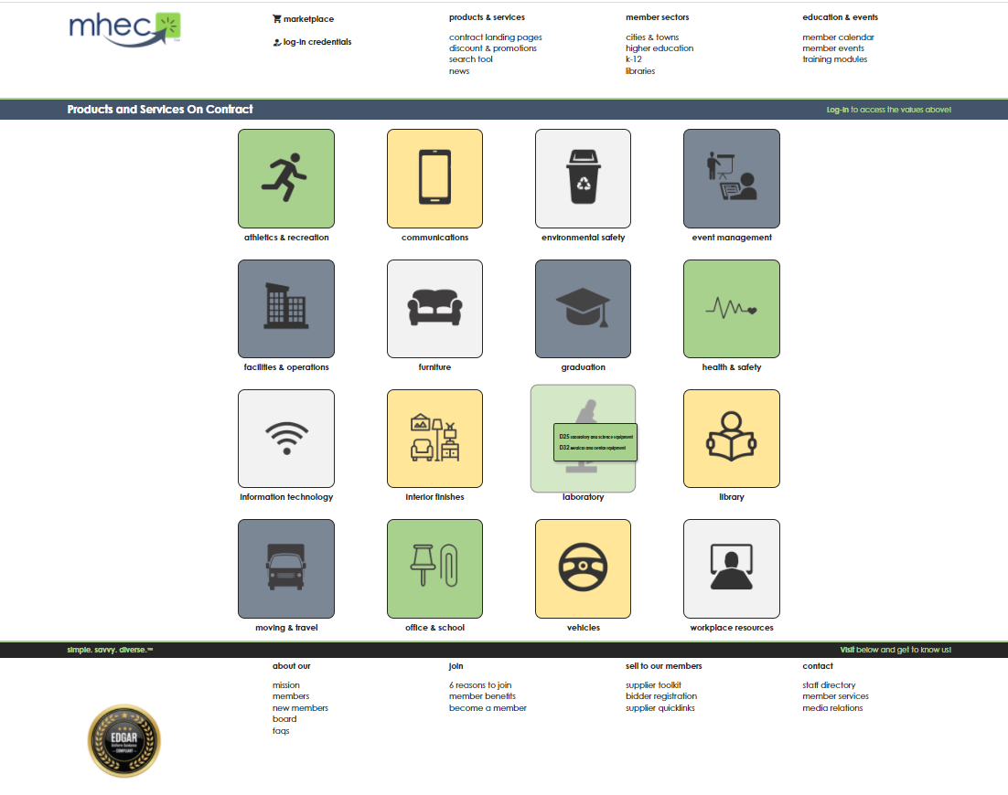
contract landing pages
simplifies through 16 high level product & service categories
centralizes purchasing-decision information by contract
lists suppliers and identifies
prices lists
sell sheets
SDO status
marketplace status / link
brand and product categories
contract news
supplier promotions/discounts
Notes:
Presenter:
You spoke, we listened. After gathering some feedback on what members would like to see when searching for products and services, our contract landing pages were born; created as a hub for all information on contracts. Our contract landing pages were designed to make finding products and services easier; keeping all information per contract in one place.
MHEC offers over 50 contracts, which have been organized by 16 high-level product and service groups. Once on this page, members will find any of our contracts, which have been sorted into one or more of the 16 groups shown above. After a member has selected a contract they’ll be redirected to its new landing page.
In our new contract landing pages, members will find key supplier, contract, promotions and news related to that contract. Members will be able to view the full contract PDF, access frequently asked questions about the contract, contact the contract manager, and sign up to add themselves to that contract’s mailing list when there will be updates related to that product and services group.
In addition, members find all suppliers on that contract, supplier 2-sided sell sheets, products and services offered in the contract, and news and promotions, such as recent supplier articles from our monthly general bulletins, valid discounts being offered, and supplier eBlasts.
Also available will be supplier videos, which are a new marketing opportunity we will be offering for a fee. We’ll be sending you more information about that in the near future as well as an additional complimentary opportunity to provide an 8.5x11 PDF to go as the back side of the sell sheet to promote your contract offering.
Members will also notice icons next to listed suppliers. These icons identify marketplace participants, available price lists, and diverse businesses.

Slide 27
“good-bye” to the bulletin – “hello”
1st Monday monthly member digest

Slide 28
Any questions?
Thank you!

